Slide 1

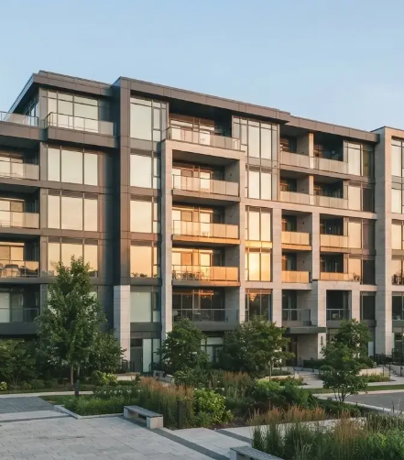
Asset Protection
Asset Protection Program
Maximizing ROI through proactive
system management
5400 W Rosecrans Ave Ste 105 Hawthorne, CA 90250
(310) 297-2737

Slide 2


The Investor's Case
for Protection
Why proactive maintenance is a financial
imperative
Reactive Approach
Proactive Preservation
Shifting away from "run-to-fail" models that incur high
Strategic management that directly improves Net
emergency costs and tenant dissatisfaction.
Operating Income (NOI) and long-term asset valuation.

Slide 3
HVAC: Efficiency and Longevity
Reducing the largest energy draw in the building
HVAC Benefit
Saves energy,
Operational
improves
Efficiency
performance
Component
Prevents failures,
extends lifespan
Protection

Slide 4
HVAC Cost-Benefit Analysis
Comparing emergency repairs vs. scheduled protection
30%
25%
Emergency service calls
Equipment life cycles
30% reduction in emergency service calls
25% extension in equipment life cycles

Slide 5
Electrical System Integrity
Mitigating risk and ensuring operational continuity
1
2
Thermal
System
Imaging
Hardening

Slide 6
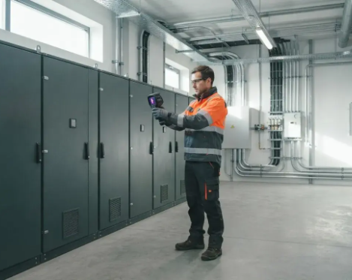
Electrical Savings &
Safety
The hidden ROI of electrical asset
protection
Risk Mitigation
Liability Protection
Measurable reduction in fire risk, often leading to lower
Avoiding tenant business interruption claims and the high
insurance premiums and improved compliance.
cost of emergency electrical restoration.

Slide 7
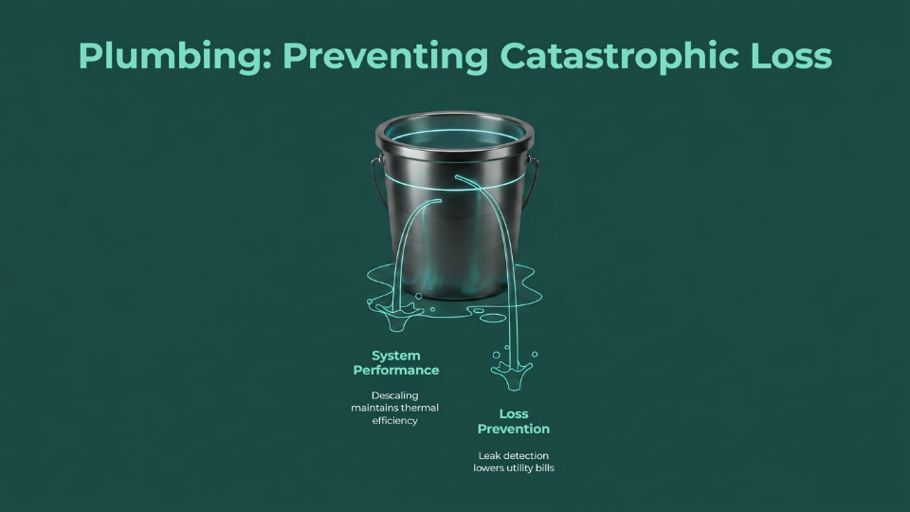

Slide 8
Plumbing Management: Balancing Savings
and Prevention
Avoid Large
Lower Monthly
Capital Expenses
Costs
Utility Bill Reduction
Damage Prevention

Slide 9
Projected Annual Savings from Asset
Protection
Percentage Reduction in
Annual Spend
20%
15%
10%
Savings
Category
HVAC Savings
Electrical
Plumbing
Savings
Savings

Slide 10
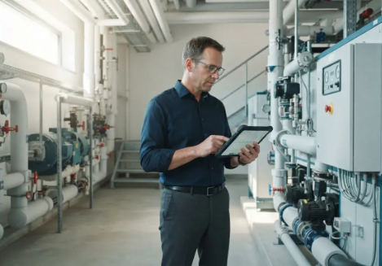
Implementation
Roadmap
Seamless integration into building
operations
01
02
03
Initial Audit
Program Launch
Optimization
Comprehensive system assessment and baseline
Deployment of scheduled maintenance and
Quarterly performance reporting and
performance tracking.
monitoring protocols.
continuous ROI adjustment.

Slide 11

Conclusion
Conclusion: Protecting the
Asset
Securing long-term value for building
investors

